Slide 1
Predicting NFL Game Outcomes
Data Science Certificate - Cohort 17 - Georgetown University
Peter Coiley, Chris Hurd, Chris Whitcomb

Slide 2
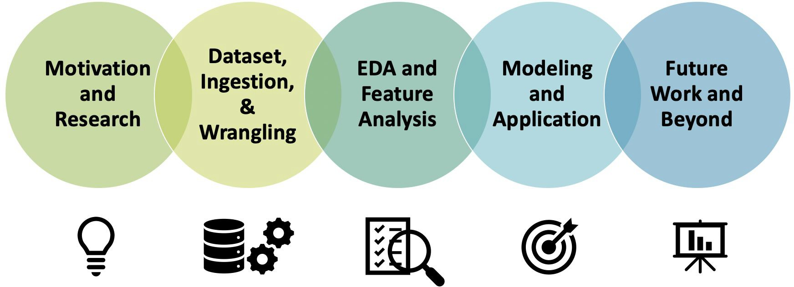
Agenda - Chris

Slide 3

Research & Inspiration

Slide 4
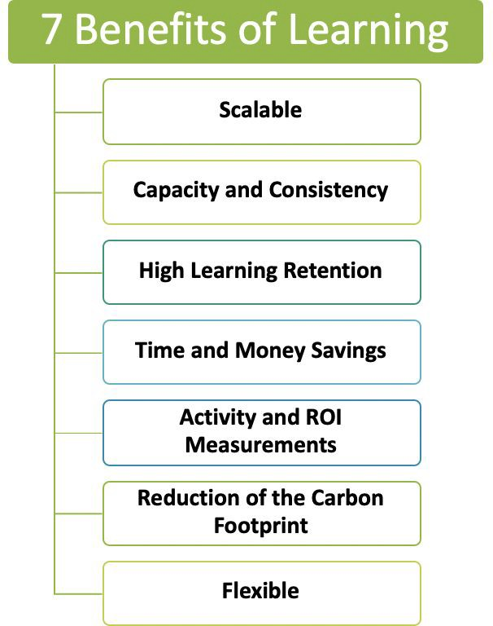


Background Research - Peter
Learning analytics is critical to online learning
“Since the year 2010, online learning have grown by +900%”
- elearningindustry.com

Slide 5

Hypothesis and Motivation – Chris W,
Business Goal and Motivation
If we can predict what students are at risk of failing a class, teachers can provide support for better learning outcomes.
Questions
What are the key features of success in a class?
What role do demographics play in student’s chances at success? If so, does this speak to biases in our society?
Hypothesis
The higher amount of overall Virtual Learning Environment interactions should improve the chances of a student receiving a passing grade.

Slide 6
Research & Inspiration

Slide 7


Dataset, Ingestion, & Wrangling

Slide 8
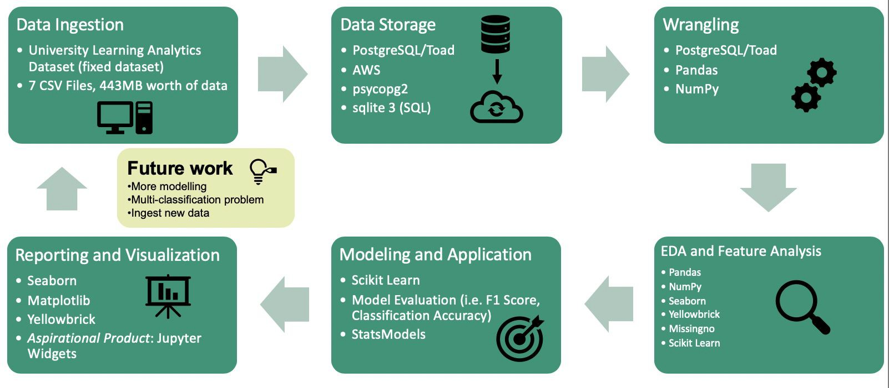
Data Science Pipeline – Chris W.

Slide 9













Our Data Science Toolkit - Peter

Slide 10
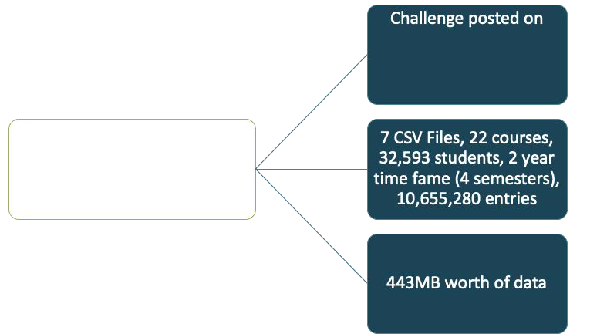


Dataset from 2013-14 (4 Semesters) Open University in the UK – Peter C.
Finalized Dataset
Instances: 28,910
Original Features: 15
Engineered Features: 25

Slide 11
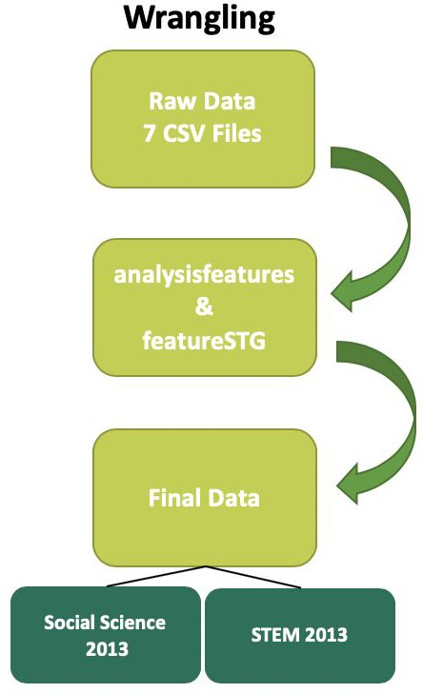
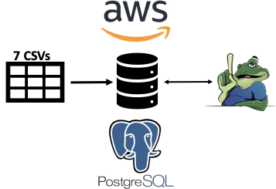
Data Ingestion, Storage, & Wrangling Process - Peter
Data Ingestion and Storage

Slide 12
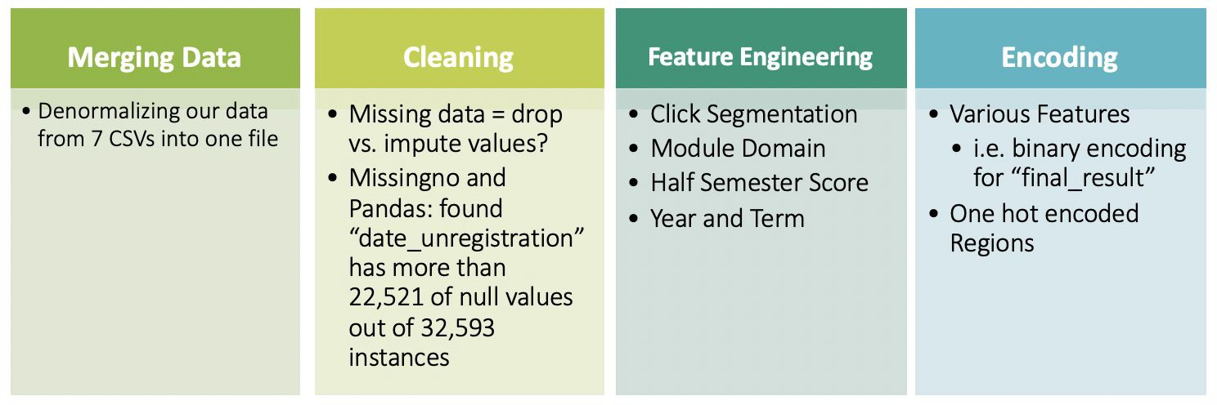
Data Wrangling – Chris H.

Slide 13
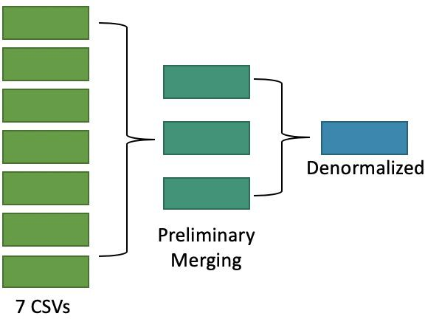
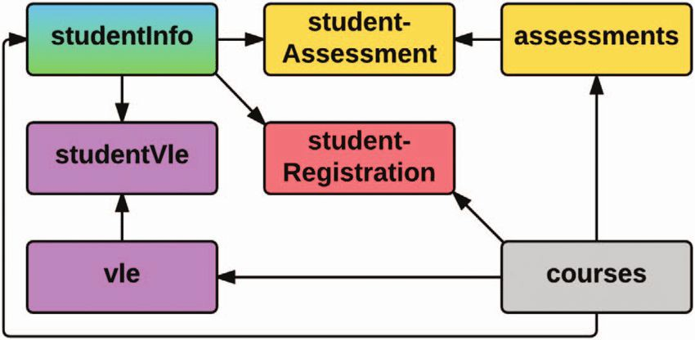
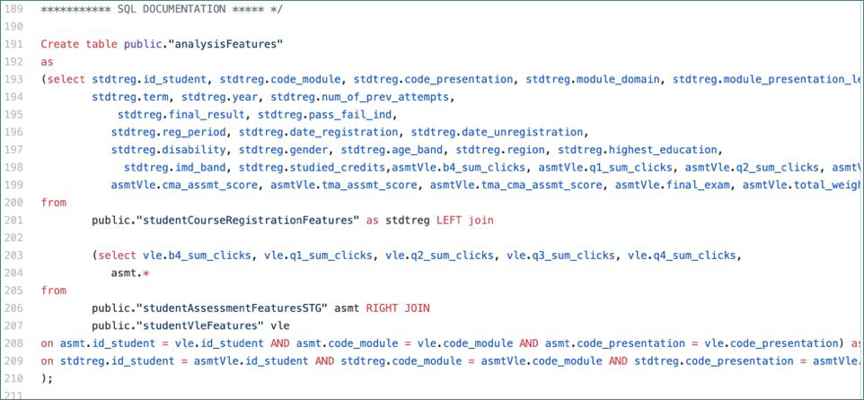
Merging the Data – Chris H.

Slide 14
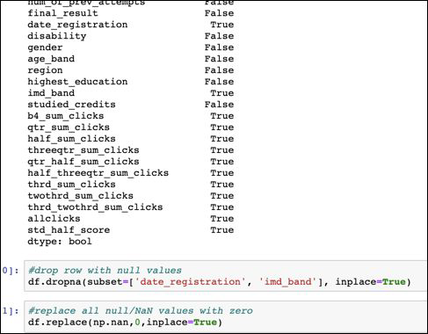
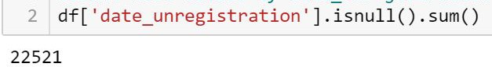
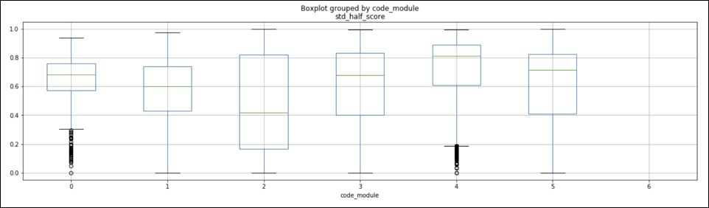
Cleaning the Data – Chris H.
Addressed Null Values in Data
Number of null values of Date Unregistration
Dropped “GGG“ Preparatory Course Module

Slide 15
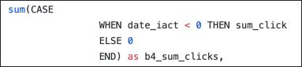
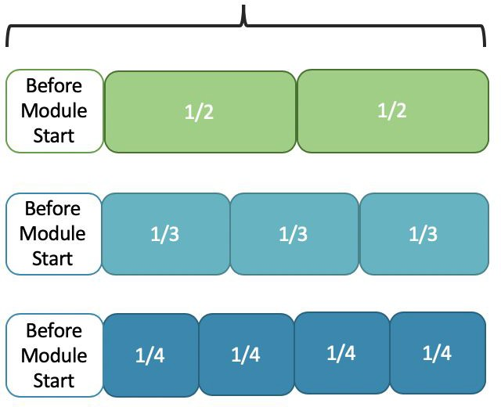
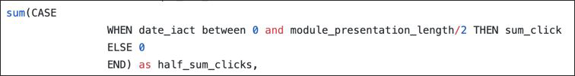
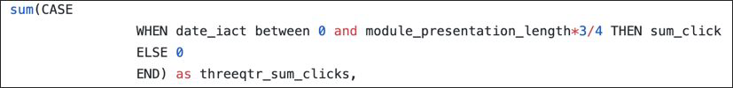
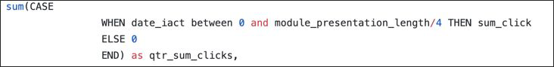
Feature Engineering: Clicks (Student Behavior) – Chris H.
Sample Code
Different Breakdowns of Total Clicks (Student Behavior) throughout a course to test out in Machine Learning

Slide 16
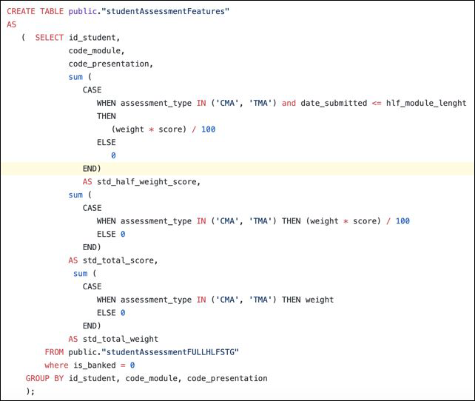
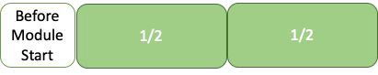

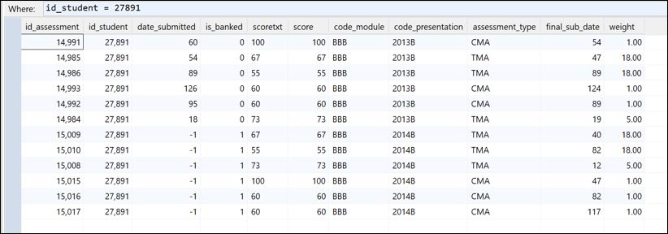

Feature Engineering: Student Scores and Weights – Chris W.
Student score = halfway point in the module
Problem:
Assessment scores of re-enrolled
Student transferred, found in EDA
Solution:
Final_sub_date < hlf_module_length

Slide 17
Research & Inspiration

Slide 18

Computation: Exploratory Data Analysis

Slide 19
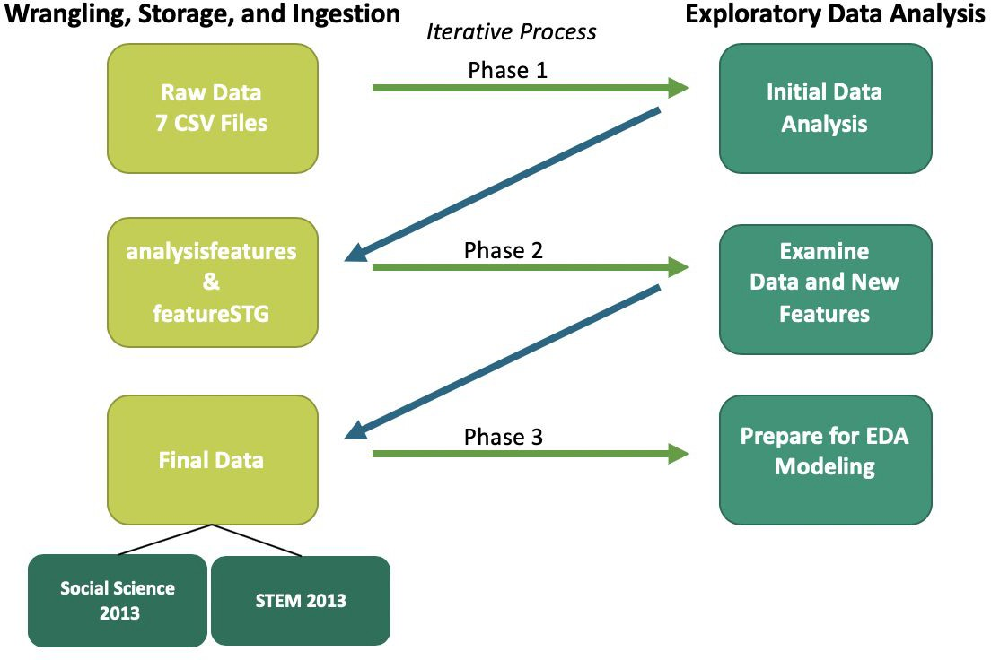
Exploratory Data Analysis Process – Chris & Chris

Slide 20
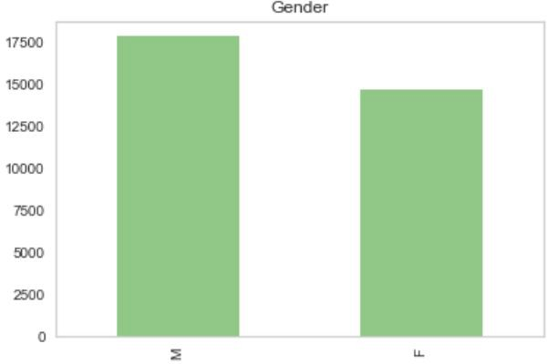
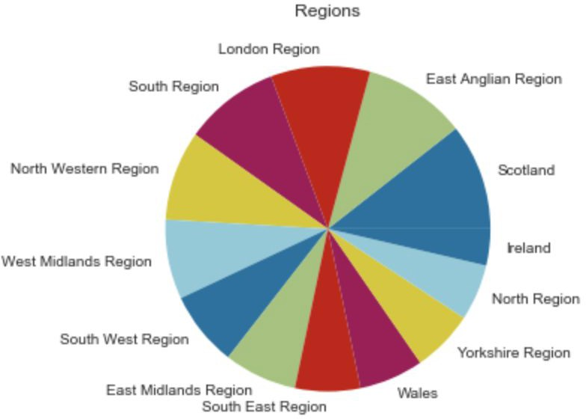



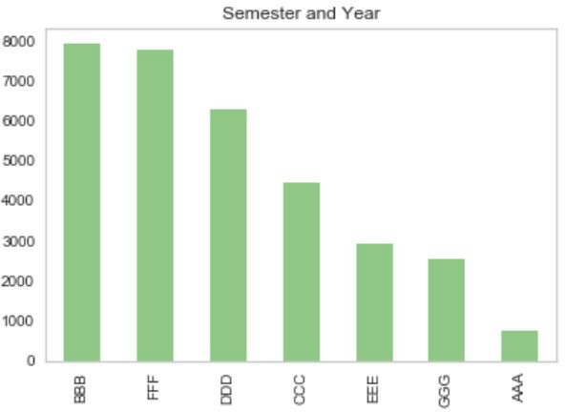
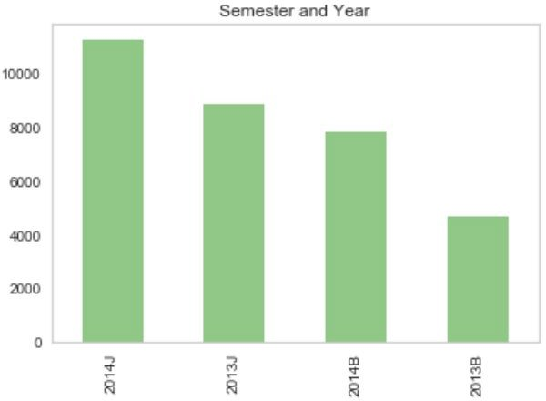
EDA: Initial Data Analysis Overview – Chris & Chris
32,593 Student IDs
55%
45%
28,785 Unique
7 Modules
4 Semesters (2013-2014)
Other features:
Poverty Index Band
Age Band
Previous Attempts
Studied Credits
Disability
Education Level
Student Activity: Sum Clicks

Slide 21
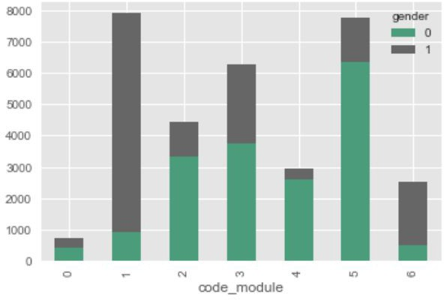
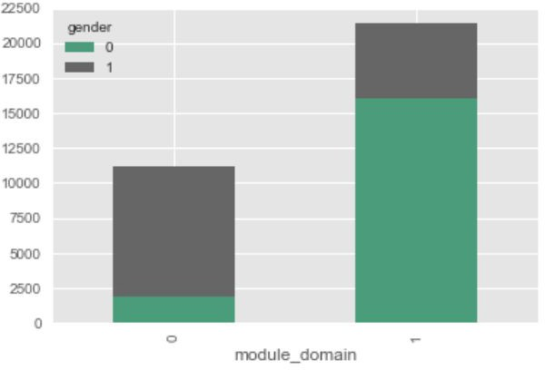
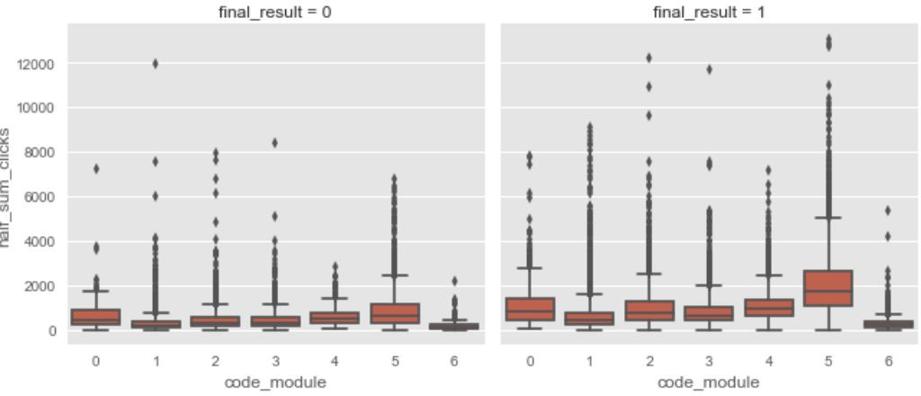
EDA: Examine Data and New Features – Chris and Chris
Course Modules vs. Module Subject on Gender
Target Variable: Final Result on Clicks

Slide 22
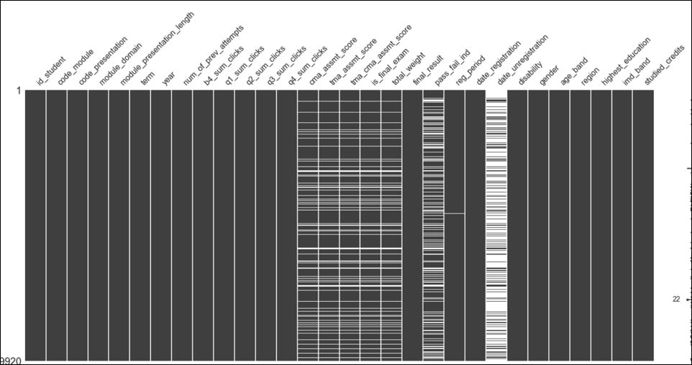
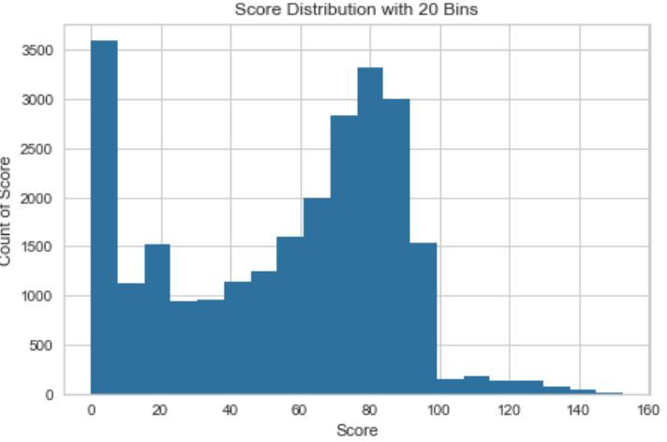
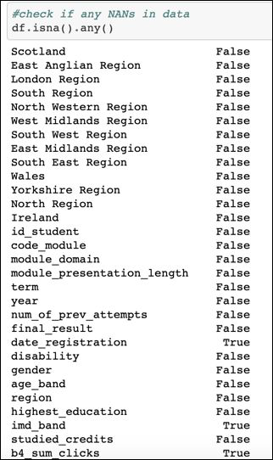

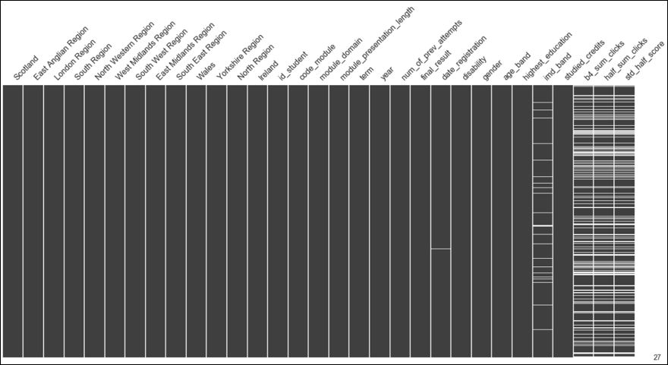
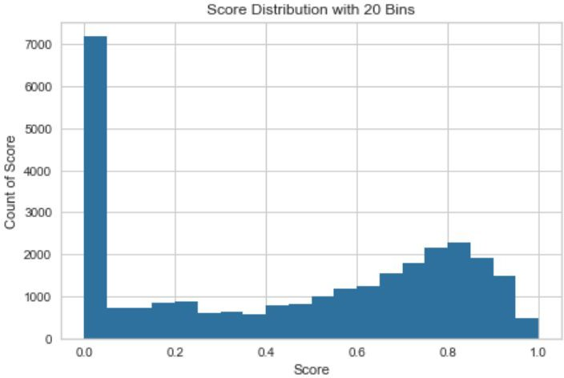
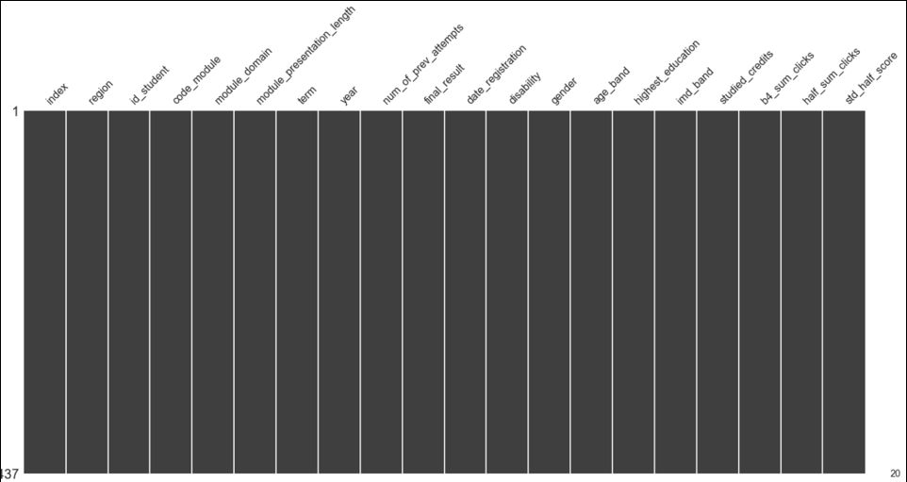
EDA: Prepare Data for Modeling – Chris and Chris
Found Error in Score Bins
Code Used to Check NaN Values
Missingno Tool

Slide 23
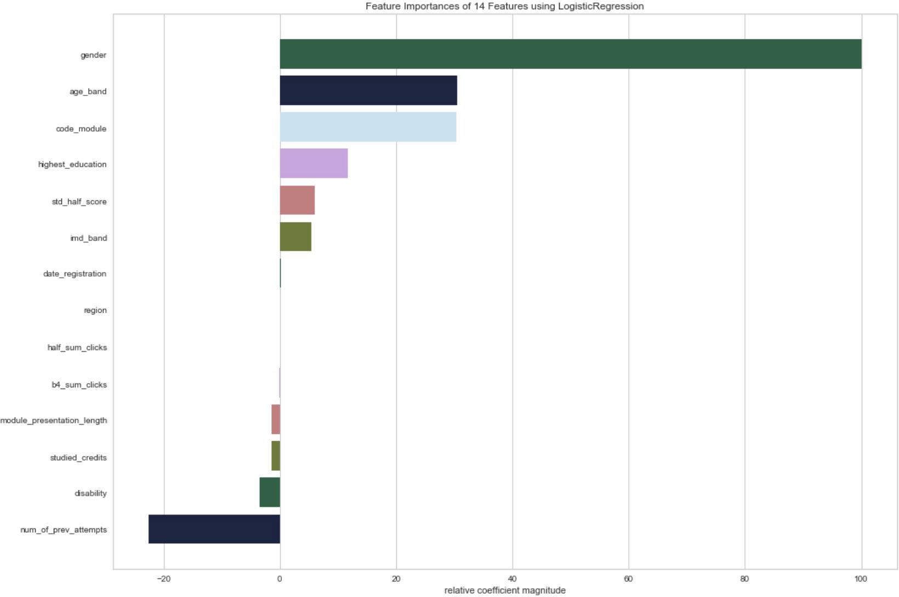
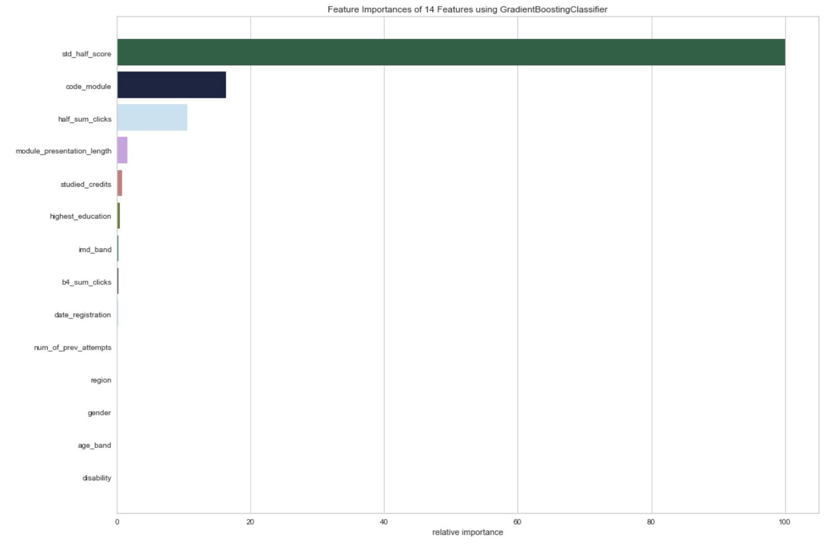
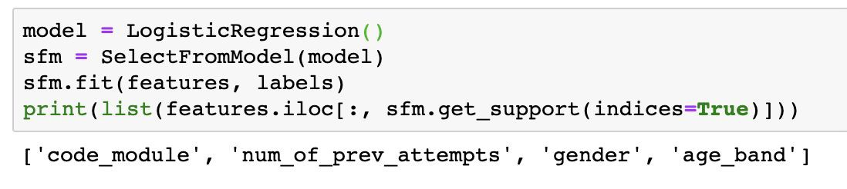
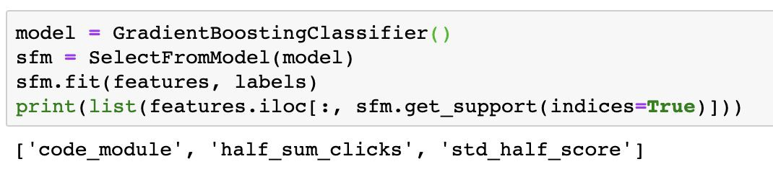
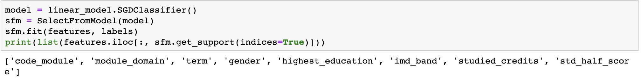
Feature Analysis – Peter
Logistic Regression
Gradient Boosting Classifier
SGDClassifier

Slide 24
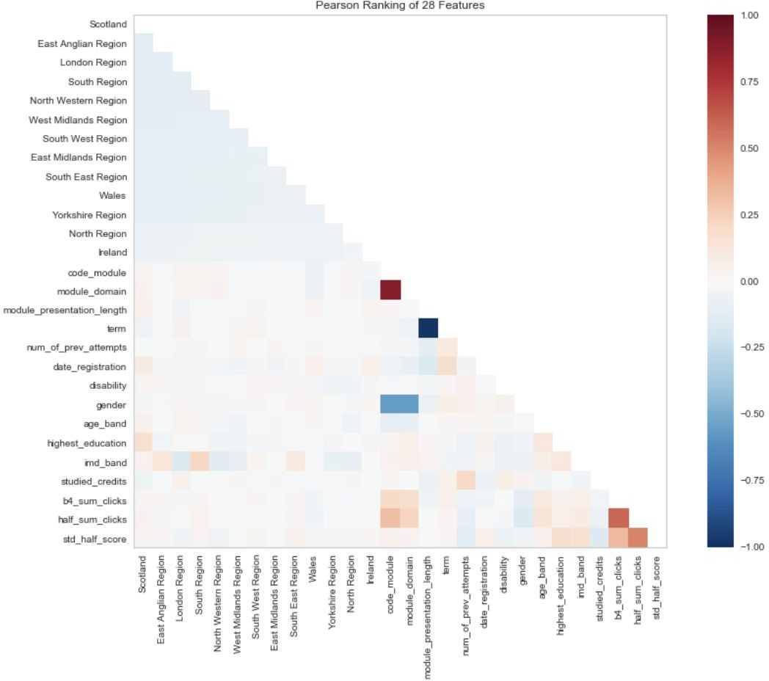
Feature Analysis Pearson’s Correlation - Chris W.

Slide 25
Research & Inspiration

Slide 26

Modeling and Application - Peter
Note that we conducted two different modeling analyses in parallel labeled as Track 1 and Track 2.

Slide 27
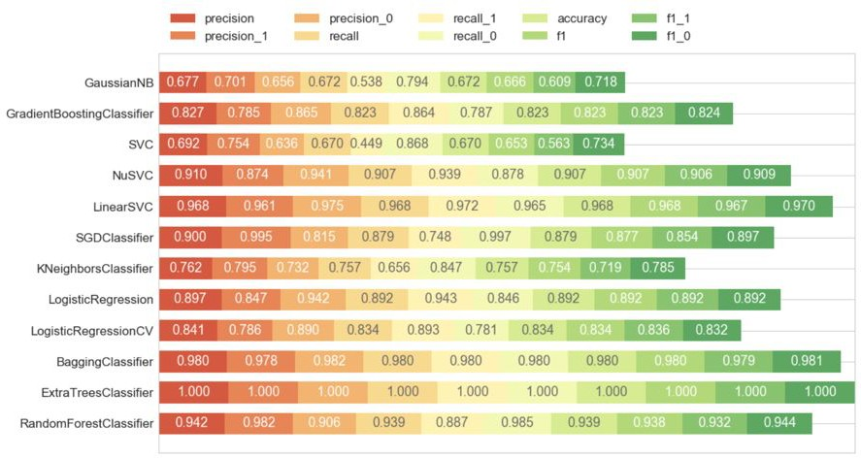
Model Evaluation - 2013 Data
Track 1

Slide 28
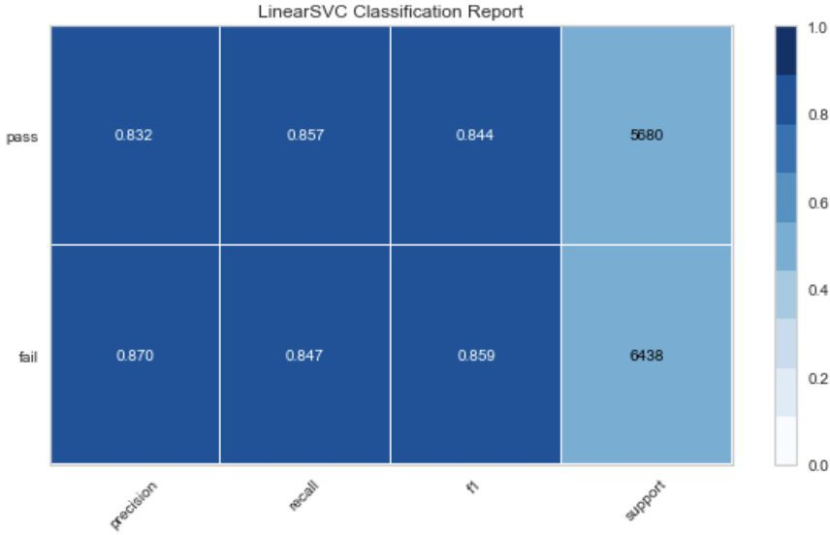
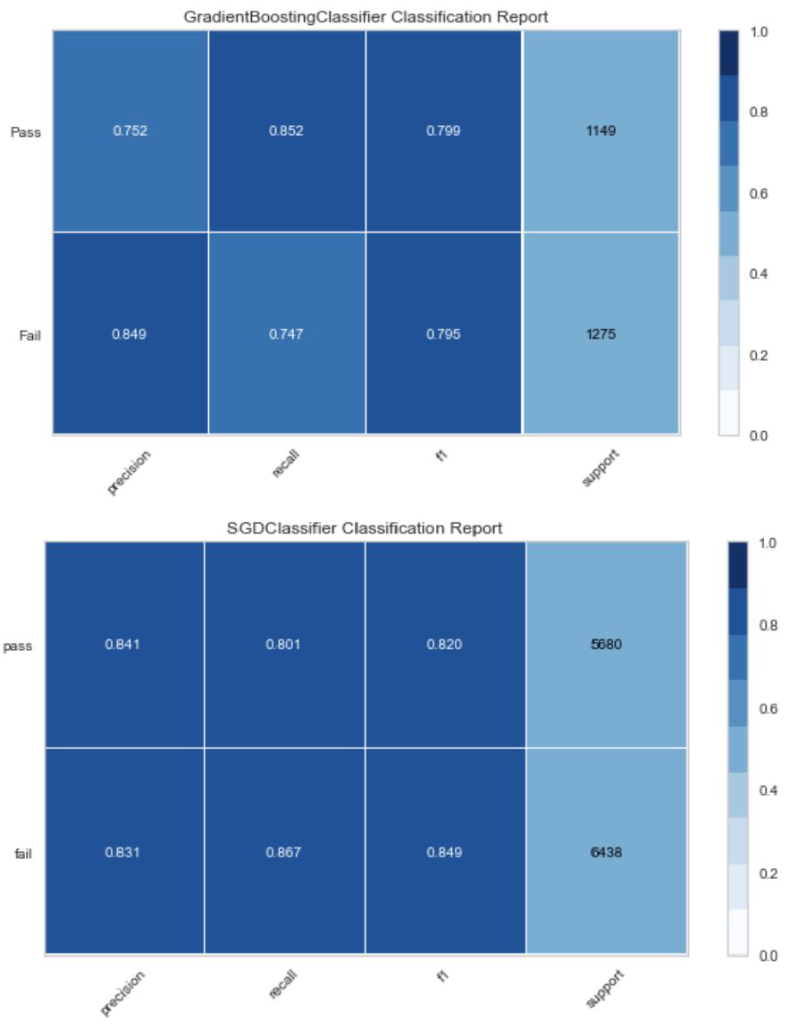
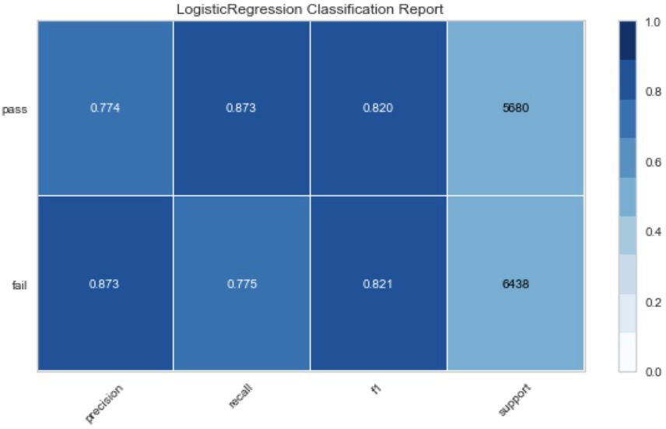
Classification Reports
GradientBoostingClassifier
LinearSVC
LogisticRegression
SGDClassifier
Track 1

Slide 29
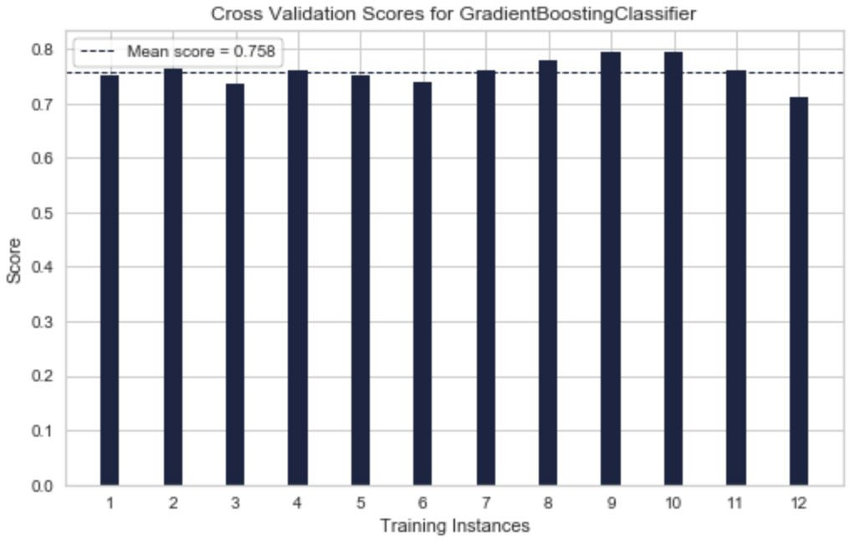
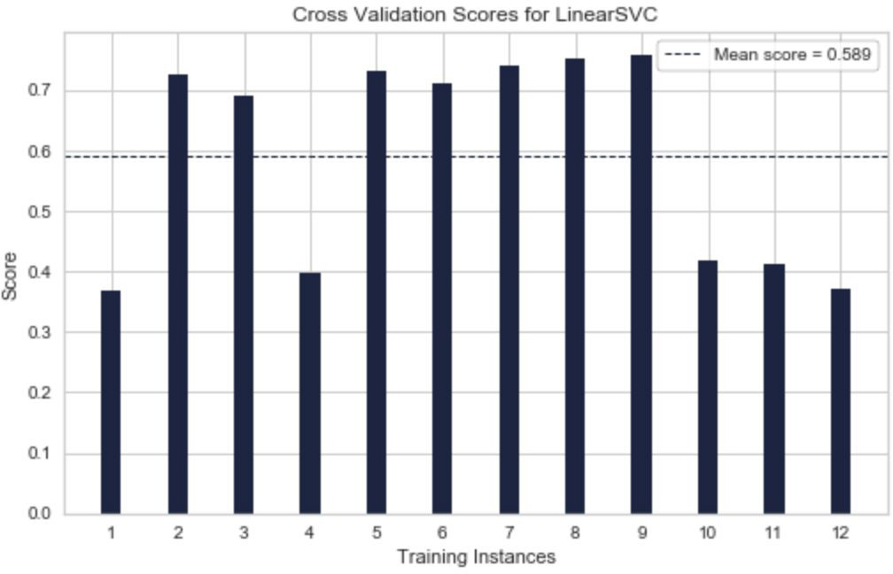
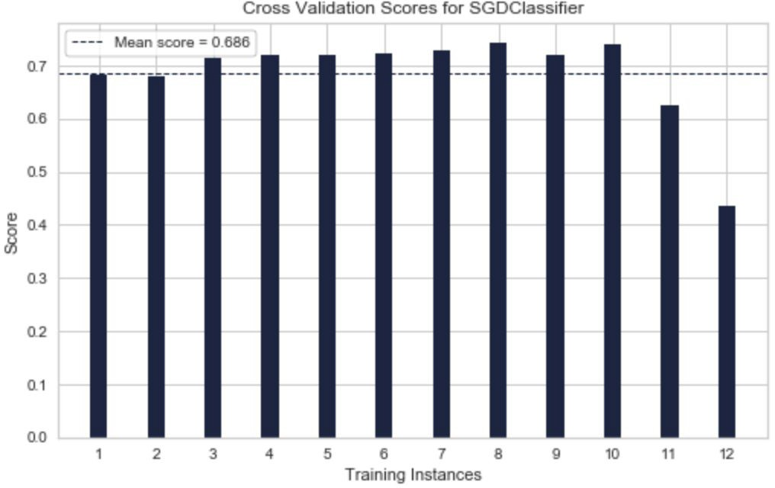
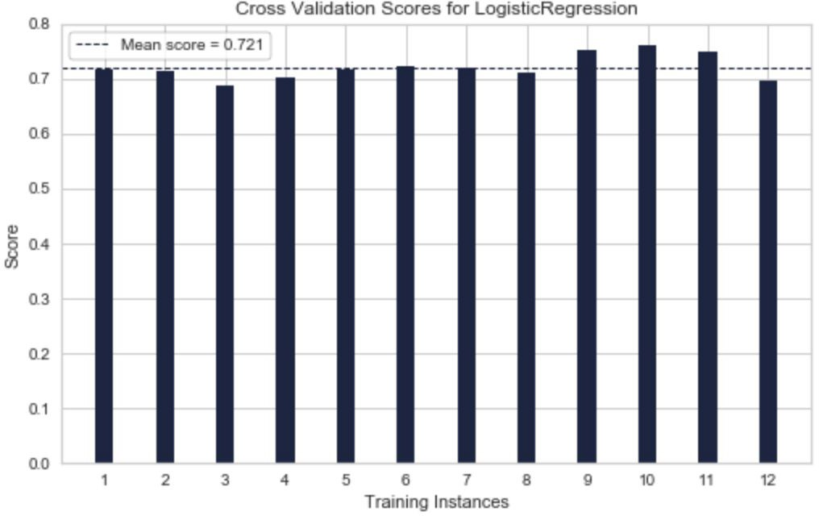
Cross Validation
GradientBoostingClassifier
LinearSVC
LogisticRegression
SGDClassifier
Track 1

Slide 30
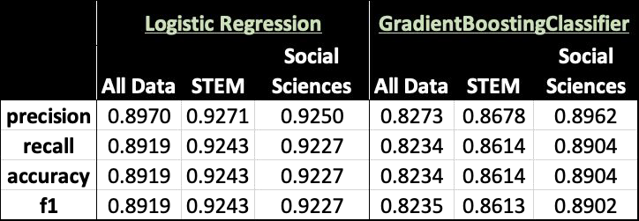


Model Summary Results
Breakdown of Student Click Behavior in 2013 by Module Domain
Track 1

Slide 31


Logistic Regression - 2013 Data Use Selected Features
Logistic Regression Accuracy rate: 87.7%
Track 2

Slide 32

Logistic Regression - Use Model to Predict 2014 Dataset
We used the model to predict the 2014 students’ performance.
The results show that we have an overall accuracy 85.2%. The recall rate for predict students that fail the class is 87%.
Track 2

Slide 33

Gradient Boosting Classifier-2013 Data with Selected Features
Feature Importance Model (top 3 features) (‘'std_half_score','half_sum_clicks','b4_sum_clicks'’), the model’s accuracy is 88.9%.
Hyperparameter Tuning: altering the learning rate of the model, as well as the n_estimators.
Results: learning rate of 0.01 and n_estimators of 1250. The accuracy rate for the GBC slightly improves from 88.9% to 89.3% after hyperparameters tuning.
Track 2

Slide 34

Gradient Boosting Classifier-Use Model to Predict 2014 Dataset
The recall rate for predict students that fail the class is 87%, which is very close to the results of the Logistic Regression.
Track 2

Slide 35


Linear SVM-Classification Report
SVM provides the highest recall rate for predicting fail students among all the other models.
If we use Linear SVC to predict the 2014 dataset as a test set, for the 2014 Combined STEM and Social Science dataset, we have overall 9,327 students that fail the class, Linear SVC model predicts 8,385 them correctly.
Track 2

Slide 36


Criteria and Limitations - Peter
Code_module = imbalance of STEM (4 courses) vs. Social Sciences (2 courses)
Potential bias in gender skew for module_domains?
Data Complexity in Entity Resolution (Student Withdraws and Reenrollment)
Data only relevant to UK regions
Module Domain by Modules Module Domain by Gender

Slide 37


Data Application: Product – Chris H.
Imagine you’re a professor hoping to help out your students:
Your class only
Check status half-way through the semester
Identify at-risk students
Coming Soon!
Product Demo

Slide 38

Future Work and Beyond

Slide 39
Future Work and Lessons Learned - All
Future Work
Test out other combinations of click data (features already created for thirds and quarters)
Look at types of click activity (ex. web vs. video)
Time-series analysis throughout the semester
Analyze assessment and class activities (ex. literature vs. biology)
Consider timing of an assessment (This could drive module construction)
Lessons Learned
Technical
Remember the business questions you are trying to answer
Ruthless version control
Push to GitHub faster and iterate
Team
Delegation of tasks
Project management and agreement on rules of accountability
Strategy for teaching others as you go to bring everyone along

Slide 40
Thank You!
Q&A

Slide 41

Appendix

Slide 42

Model Summary Results (Expanded) - Peter

